Slide 1


Which Election?

Slide 2

Inquiry questions
What kinds of elections do we have in Canada?
How can I engage in the process?

Slide 3
Minds on
Think about a time when you had to work together in a group whether at school, at home, or in your community.
Did you have to divide up the tasks among different people?
How did you decide who did what?

Slide 4
Minds on
How do you think the task of governing Canada is divided?
federal
provincial/ territorial
municipal/ local

Slide 5
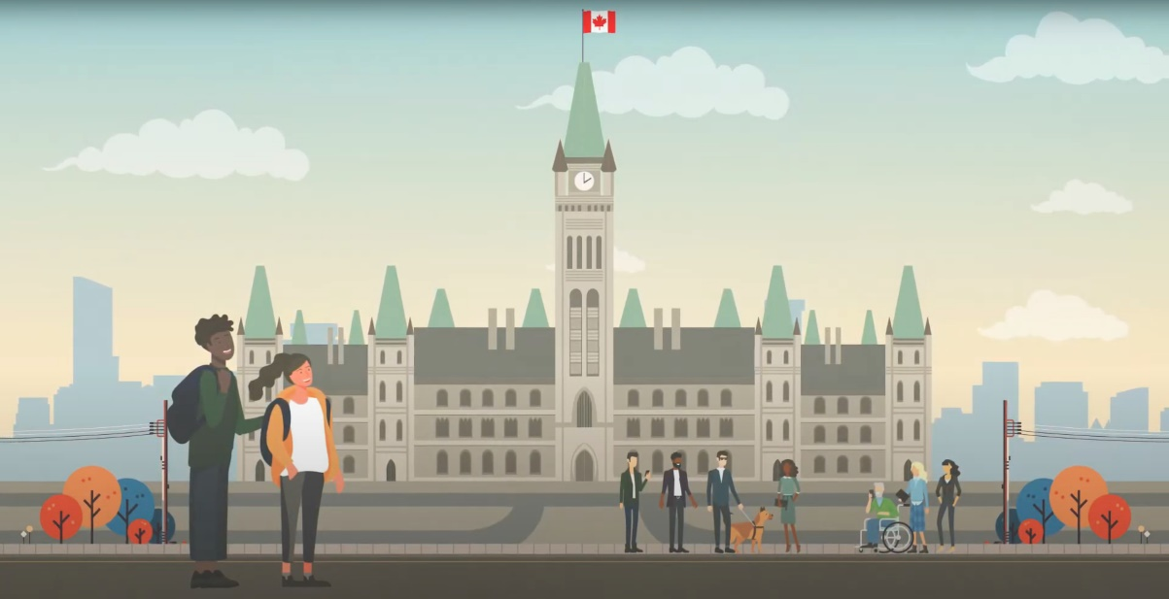
Minds on
Watch the Three Levels of Government video.
What responsibilities do you observe in the video?

Slide 6
Minds on
What responsibilities did you observe in the video?
Discuss with a partner, then share your observations with the class.

Slide 7
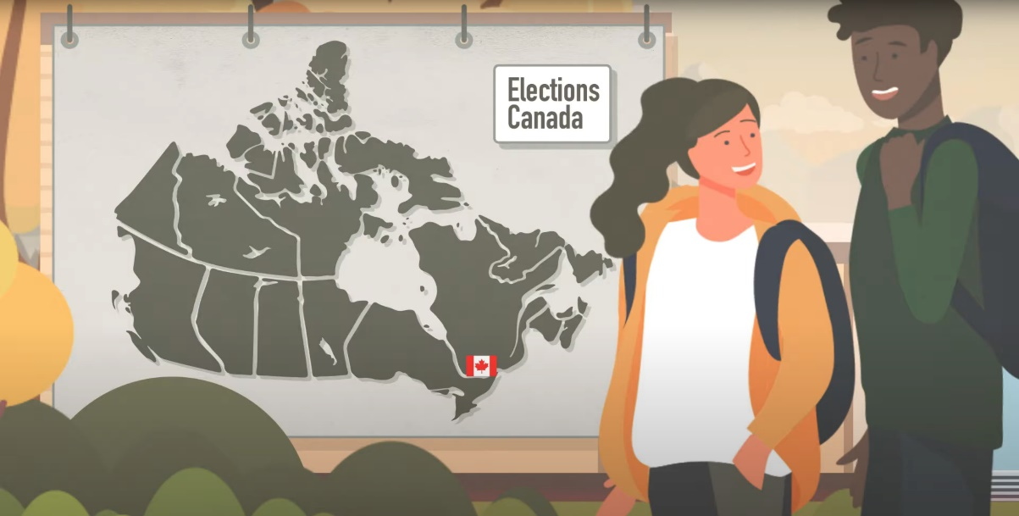
Activity
Watch the Three Levels of Elections video.

Slide 8
Activity
Three Levels of Elections
Talk with a partner.
Share something you have learned.
What questions do you have?

Slide 9
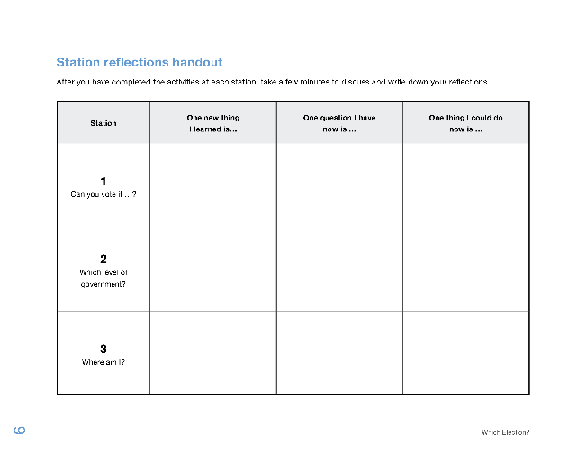
Activity
Your task:
Complete the activities as a group at three learning stations. Use the station reflections handout to reflect individually.
You will need:
the station reflections handout
a pen or pencil

Slide 10
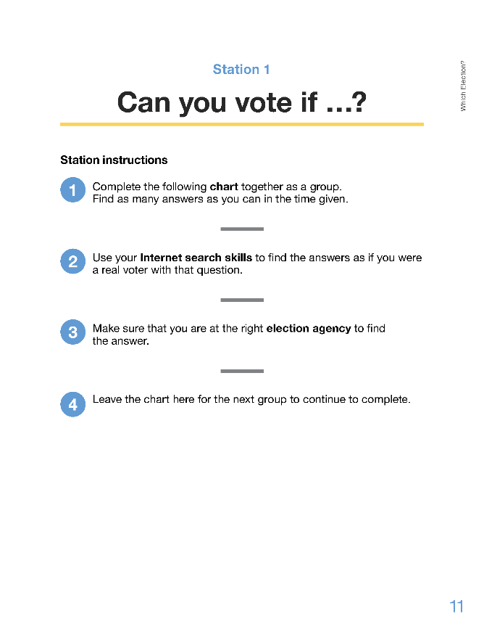
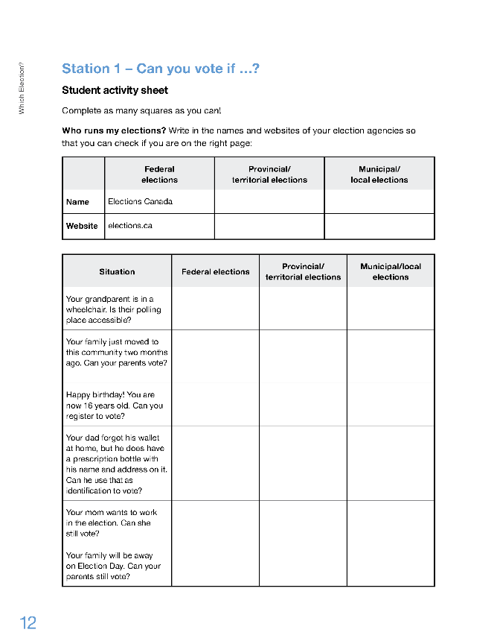
Activity
Station 1 – Can you vote if...?

Slide 11
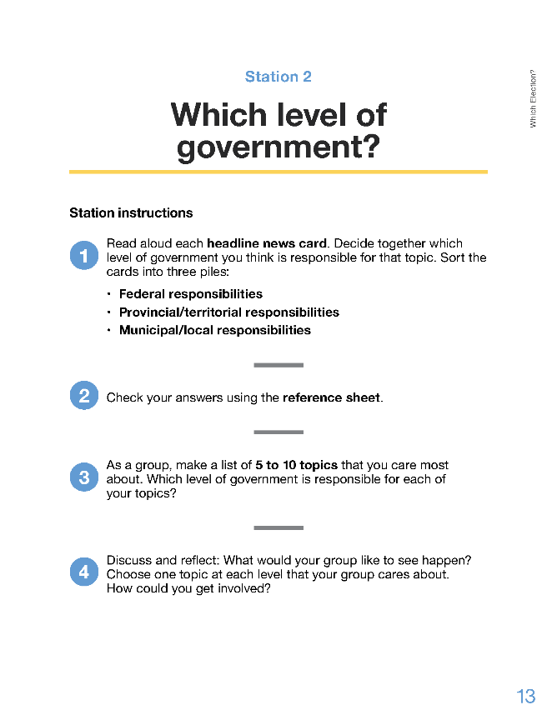
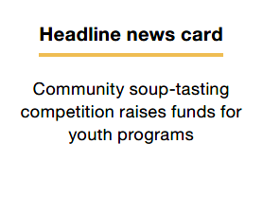
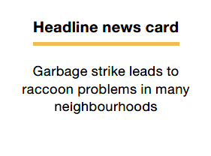
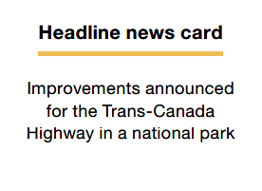
Activity
Station 2 – Which level of government?

Slide 12
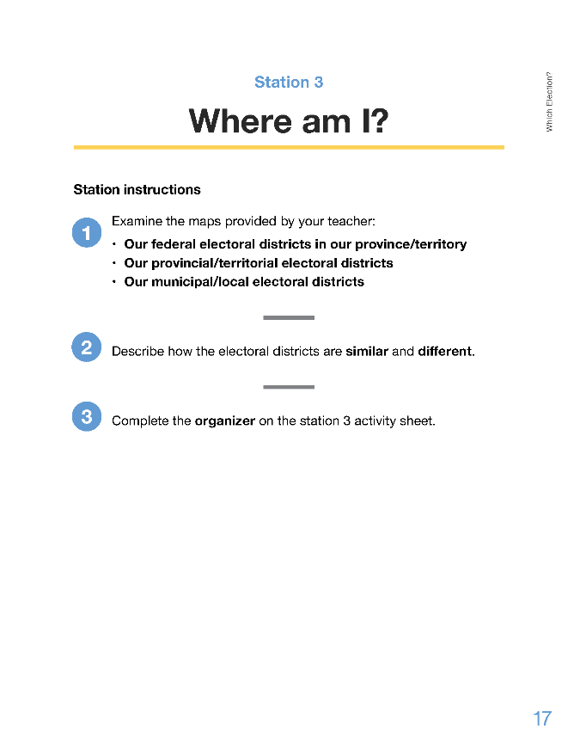
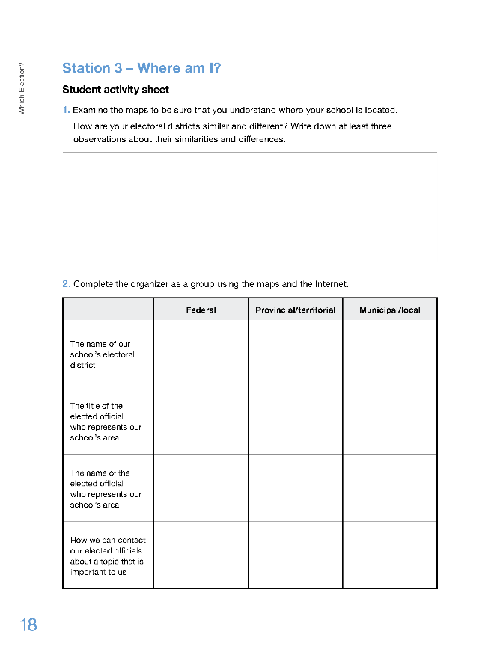
Activity
Station 3 – Where am I?

Slide 13

Activity
First Rotation – 10 Minutes

Slide 14

Activity
Second Rotation – 10 Minutes

Slide 15

Activity
Third Rotation – 10 Minutes

Slide 16
Consolidation
Complete the station reflections handout.
Which of your reflections was the most helpful in answering the inquiry questions?
What kinds of elections do we have in Canada?
How can I engage in the process?
Share your thoughts with a partner or small group. Write down your final reflections.

